Slide 1
Safe-Medication use for elderly

Slide 2
Response of older adults to drugs
Problems related to medications are common in older adults, and they are costly in terms of both time and money.
Medications can alter an older adult’s ability to perform normal functions, can result in behavior changes, and can be life threatening.
Adverse drug reactions (ADR) are common in older adults.

Slide 3
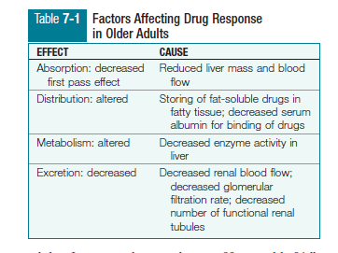

Slide 4
Pharmacokinetics
The movement of a drug in the body from the point of administration as it is absorbed, distributed, metabolized, and finally, excreted.
The way the body handles a drug.
Drug absorption
Most medications are taken orally and are absorbed through the gastrointestinal (GI) tract.
First pass effect is a phase of drug absorption that is altered in the older adult. In first pass effect, oral medications take a first pass through the liver before entering the systemic circulation, greatly reducing the drug concentration.
Because of decreased liver mass and blood flow, there is reduced first pass metabolism in the older adult, which can lead to a significant increase in the effects of certain medications like propanolol and labetalol.
Other medications need to be “activated” by the liver, such as angiotensin-converting-enzyme (ACE) inhibitors (e.g., enalapril); therefore, the effect of these medications can be reduced in the older adult.

Slide 5
It was a long-held belief that gastric acid secretion decreases as we age, resulting in an increased gastric pH and reduced drug absorption.
Newer research has shown this so-called age-related change to only be present in certain disease states and not true for healthy older adults (Zwicker & Fulmer, 2012).
Likewise, decreased gastric motility and a slower emptying rate of the stomach can occur, but again, usually only in the presence of disease.
Decreased peristalsis can slow the speed at which enteric medication reaches the intestine, therefore delaying its onset of action.
Changes in the ability of the cells in the GI tract to absorb and transport the drug can further influence its absorption.

Slide 6
Drug Distribution
With aging, there is typically a decrease in total body mass, lean body mass, and total body water and an increase in total body fat which can significantly alter the distribution of medications.
Because there is less total body water, water-soluble drugs such as gentamicin, histamine-receptor blockers, and lithium tend to remain in higher concentrations in the bloodstream.
An older person who is dehydrated is at even greater risk for reaching excessive blood levels of water-soluble drugs.
As muscle mass decreases and the percentage of adipose tissue increases, fat-soluble drugs such as phenobarbital and the benzodiazepines become trapped in the fatty tissue, resulting in abnormally low blood levels.
If the dosage is increased based on these blood levels, an excessive amount of medication may be administered. Because fat-soluble drugs continue to be released slowly from the fat into the bloodstream, older persons may exhibit delayed or hangover effects.

Slide 7
A decrease in hemoglobin and the plasma protein albumin is common with aging which results in fewer available sites for protein-bound drugs, such as warfarin, phenytoin, theophylline, salicylates, and tolbutamide.
The danger of adverse or toxic reactions is high even with smaller doses due to unbound active drug which still circulates in the bloodstream.
The risk for toxicity is greater in malnourished older adults.

Slide 8
Drug Metabolism
The liver is the primary site of drug metabolism.
Aging often results in decreased activity of liver cells, decreased metabolic enzymes, and decreased cardiac output, which results in reduced blood flow to the liver.
By 65 years of age, the liver has only 55% to 65% of the perfusion of a young adult. This reduction in perfusion decreases the liver’s effectiveness in metabolizing drugs.
When drugs are not metabolized effectively by the older adult’s liver, the risk for toxicity increases.
Toxicity is always a concern with medications commonly prescribed for older adults, including digoxin, β-blockers, calcium-channel blockers, and tricyclic antidepressants.

Slide 9
Drug Excretion
Aging kidneys are significantly less effective at removing waste products, including the by-products of medications due to which more drug remains in the circulation, leading to elevated drug levels and symptoms of drug toxicity.
Medications such as aminoglycosides, digoxin, lithium, procainamide, and cimetidine are likely to reach toxic levels because of poor renal excretion.
Nonprescription drugs, such as alcohol and nicotine, can also affect kidney function and cause changes in drug elimination in older persons.

Slide 10
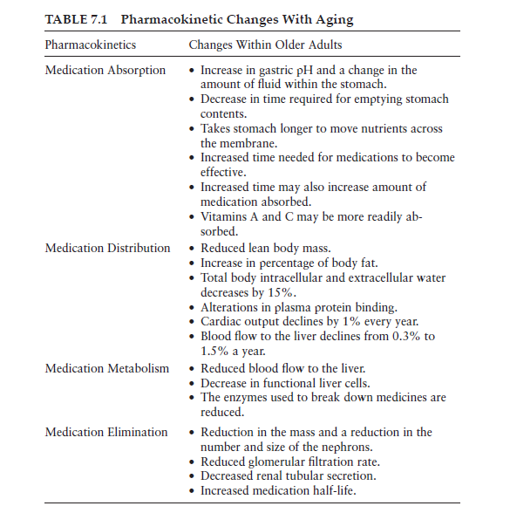

Slide 11
pharmacodynamics
The effect that a drug has on the body.
Aging is associated with enhanced sensitivity to a number of drug therapies.
The older the person gets, the more likely there will be an altered or unreliable response of the body to the drug.
For example, older people may be more sensitive to the effects of benzodiazepines, opioids, and warfarin, exclusive of any age-related pharmacokinetic changes that might exist.

Slide 12
Responses to medications are less predictable in the aging person. Pathologic changes in target organs may affect the response to medications.
Receptor sites on the target organs may respond more or less sensitively to medications. The receptors may respond normally to some medications but not to others.
Receptors often may be more sensitive to medications, placing older adults at increased risk for toxic responses.
Brain receptors are particularly sensitive, thus older adults typically respond strongly to psychotropic medications.
When the receptor sites are less sensitive, the individual may require larger-than-normal doses to achieve therapeutic effects. If receptor sites in the myocardium are affected, older people may require higher doses of common medications such as propranolol and lidocaine. Administration of these higher doses increases the risk for toxicity.

Slide 13
Medication-Related Problems and Older Adults
Polypharmacy
Polypharmacy, the prescription, administration, or use of more medications than are clinically indicated, is a common problem in older adults.
Although there is controversy about how many drugs are “too many,” polypharmacy is the term used to indicate multiple drug use, and usually this implies the use of some drugs that are duplicated or unnecessary .
Junius-Walker and colleagues (2007) define polypharmacy as taking more than five medications at the same time.
Older adults ingest far more medications than do younger people in addition to OTC medications, herbs, and supplements that may be taken with or without the primary care provider’s recommendation or knowledge.

Slide 14
Many factors contribute to the increased usage of medication among older adults, including an increased likelihood of multiple acute or chronic disease conditions; increased availability of a variety of prescription medications, OTC medications, supplements and herbs; changes in patient expectations; and changes in the health care delivery system.
It is estimated that older adults purchase 40% of all nonprescription medications. The more medications taken, including OTCs, supplements, and herbs, the greater the risk for untoward reactions, drug interactions, and drug toxicities.
Drug interactions and toxicities in older adults are likely to result in behavioral or cognitive changes, often mistaken for dementia.
The two major concerns with polypharmacy are the increased risk for drug interactions and the increased risk for adverse events.
Adverse events include adverse drug interactions and reactions, adverse drug withdrawal, and therapeutic failures.

Slide 15
Drug interaction
The more medications a person takes, the greater the possibility that one or more of them will interact with each other, with an herbal product, with a nutritional supplement, with food, or with alcohol.
When two or more medications or foods are taken together or close together, the drugs may potentiate one another, or make one or both either more or less effective.
An interaction may result in altered pharmacokinetic activity, that is, alterations in the absorption, distribution, metabolism, or excretion of one or any of th medications.

Slide 16
Adverse Drug Reactions
An adverse drug reaction (ADR) or adverse drug event (ADE) is an unwanted pharmacological effect, ranging from a minor annoyance to death and including allergic reactions.
These may be iatrogenic, drug-drug, drug-supplement, or drug-disease.
It has been estimated that a person taking two different drugs has a 13% chance of having an ADR at some point, compared to 82% of those taking seven or more drugs (Constantiner, 2011).

Slide 17
ADRs occur in all situations in which one takes or is administered medications. Older adults are four time more likely to be hospitalized for an ADR than younger persons ( Ruscin, 2009). Page and Ruscin (2006) found that 31.9% of the elders studied experienced at least one ADR while hospitalized.
ADRs are not always predictable. An older patient who is well controlled on a stable dose of a drug may undergo a change in his or her physiology or environment and the body’s response to the drug may be altered.
One of the most troublesome ADRs for the older adult is drug-induced delirium and confusion.
Others are lethargy and sexual dysfunctioning.

Slide 18
Safety and nonadherence (noncompliance) issues
Nonadherence with prescribed medication regimens is common among older adults.
Choosing to not take medication as prescribed can result in poorer health, adverse reactions, emergency department visits, hospitalization, and even death.
Drugs may be ineffective in older adults because clinicians under-dose (eg, because of increased concern about adverse effects) or because adherence is poor (eg, because of financial or cognitive limitations).

Slide 19
Promoting the use of safe drug in elderly
Improving safer use of medications in elderly
Methods to improve safe use of medications in elderly should be a multidimensional and multidisciplinary approach. This should start from the point of patient visit and should be an ongoing process involving all steps of drug use, and frequently revisited for individual patients. Prescribing step needs to be refined and more cautiously approached while prescribing in geriatrics patients.
Safer use of the drugs can be promoted with appropriate education of patient, monitoring for adverse effects and frequent review for any drug interactions.
Appropriate history taking is a vital step and equally challenging due to various inherent difficulties in this age group. Ensuring the participation of patient's caregivers in this process is essential with evaluation of use of non-prescription medications and dietary supplements, allergy history, and experience of any adverse effects or any other problem with the medications.
It is necessary to start with a low dose and titrate the medication dose slowly giving due consideration for the renal and hepatic function of the patient.
Always use the least number of drugs, routinely review possible drug toxicity, and review concomitant medications and diseases to evaluate possible interaction with new drugs. Always weigh the risks and benefits of adding new drugs to patient's existing drug therapy¹⁶.

Slide 20
Good communication is crucial to ensure safe use of medications.
Prescribers should develop an effective therapeutic partnership with the patient.
Patient and caregivers should be well educated about the appropriate dose regimen; necessary details on side effects of the medications prescribed including methods for prevention, identification, managing and action to be taken in case of developing the same.
Pharmacists need to be encouraged to take up a more active role in this process of patient education in collaboration with the prescribers.
Measures have to be taken to ensure frequent patient follow ups.
Reassessing the need of drugs in the present dose regimen has to be given priority during the routine follow ups. Any drug related problem has to be assessed at every patient visits.
Patient adherence with the suggested regimen has to be reinstated at each visit.

Slide 21
Preventing drug related problems in older people
Before starting a new drug
To reduce the risk of adverse drug effects in older adults, clinicians should do the following before starting a new drug:
Consider nondrug treatment
Discuss goals of care with the patient
Document the indication for each new drug (to avoid using unnecessary drugs)
Consider age-related changes in pharmacokinetics or pharmacodynamics and their effect on dosing requirements
Choose the safest possible alternative (eg, for noninflammatory arthritis, acetaminophen instead of an NSAID)
Check for potential drug-disease and drug-drug interactions

Slide 22
Start with a low dose
Use the fewest drugs necessary
Note coexisting disorders and their likelihood of contributing to adverse drug effects
Explain the uses and adverse effects of each drug
Provide clear instructions to patients about how to take their drugs (including generic and brand names, spelling of each drug name, indication for each drug, and explanation of formulations that contain more than one drug) and for how long the drug will likely be necessary
Anticipate confusion due to sound-alike drug names and pointing out any names that could be confused (eg, Glucophage® and Glucovance®)

Slide 23
After starting a drug
The following should be done after starting a drug:
Assume a new symptom may be drug-related until proved otherwise (to prevent a prescribing cascade).
Monitor patients for signs of adverse drug effects, including measuring drug levels and doing other laboratory tests as necessary.
Document the response to therapy and increase doses as necessary to achieve the desired effect.
Regularly reevaluate the need to continue drug therapy and stop drugs that are no longer necessary.

Slide 24
Alternative medications in elderly
The use of complementary and alternative medicine (CAM) is increasing rapidly, exceeding prevalence of 53% among those aged 50 years and above in a joint survey by American Association of Retired People (AARP) and National Center for Complementary and Alternative Medicine (NCCAM).
Due to natural ageing processes, elderly populations are more susceptible to chronic health conditions. CAM has caught the attention of many older adults and their caregivers as CAM often offers gentler and safer approaches to addressing common health conditions suffered by elderly.
CAM, as defined by NCCAM, is a group of diverse medical and health care systems, practices and products that are not generally considered part of conventional medicine.
CAM includes such products and practices as herbal or dietary.

Slide 25
Older adults use CAM for various reasons, including lower costs, the search for more effective therapies, improving the quality of life and for pain relief.
Many older adults have turn to CAM therapies for treating their conditions, as they believe that CAM therapies are generally more “natural” and safer than conventional medicine and provide greater relief of symptoms and CAM being consistent with their beliefs and philosophical orientation toward health and illness as well.
CAM plays a substantial role in the health promotion, treatment and prevention of diseases and frailties in elderly people, which encompasses the wholesome approach of handling ageing and its effect as well.

Slide 26
Refer to your textbook.

